Slide 1
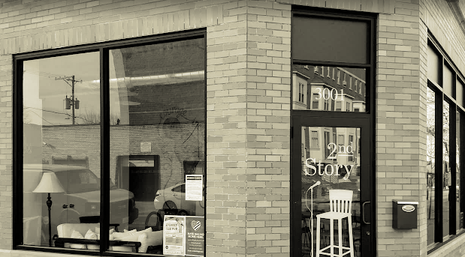
Strategic Marketing Project
Final Presentation
July 16, 2025
Notes:
Speaker: Jennessa

Slide 2
Agenda
Introductions
Compass overview
Compass team introductions
Project Background and Engagement Scope
Phase I Discovery Review
Phase II – Marketing Plan, Implementation Roadmap Recommendations
Plan Summary & Discussion
Notes:
Speaker: Jennessa

Slide 3


Who is Compass Pro Bono?
Vision
Deeply interconnected communities.
Mission
Compass Pro Bono forges lasting ties between local nonprofits and local business professionals to empower thriving, equitable, resilient communities.
Registered 501(c)(3) organization

Slide 4




23 Years of Experience
8600+ volunteer
matches
3150 nonprofits
served
$145 million
in pro bono services to local nonprofits
8600+ volunteer
matches
1520 pro bono
consulting projects
310 business leaders placed
on nonprofit boards

Slide 5
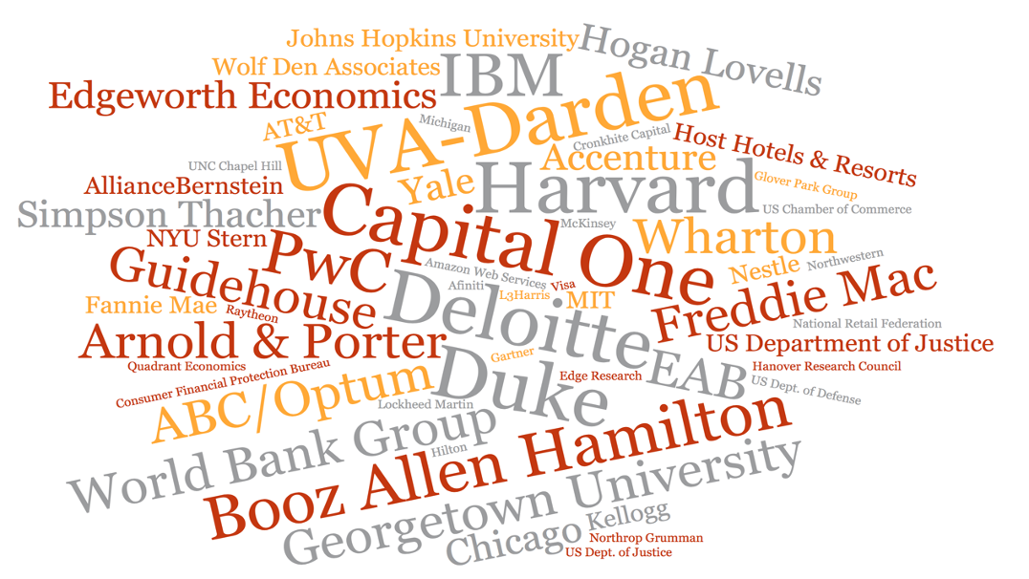
Compass Pro Bono Value – Volunteers

Slide 6
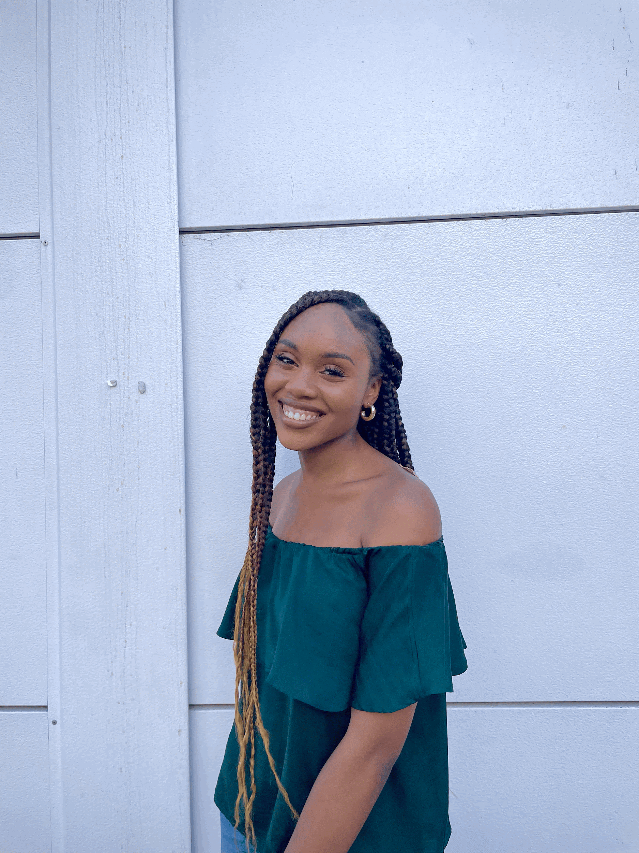
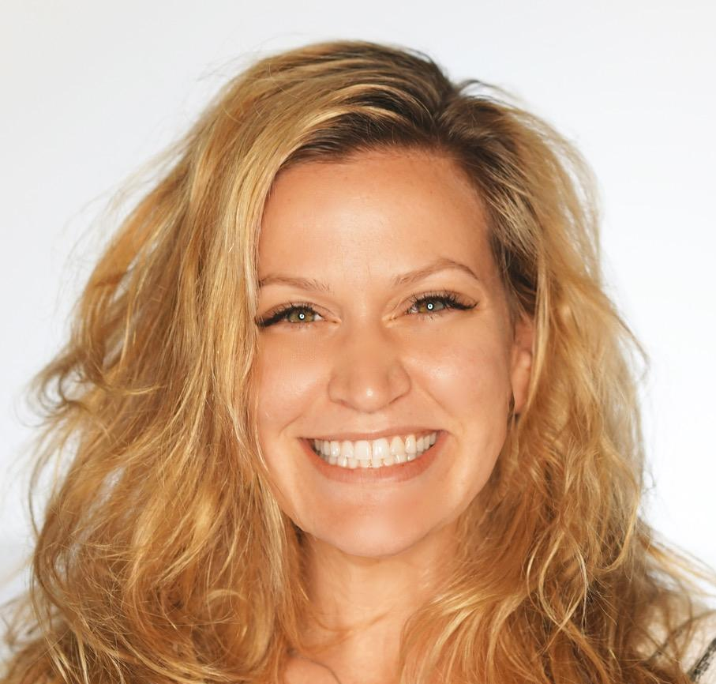
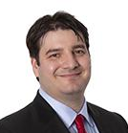
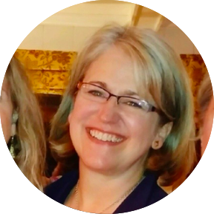
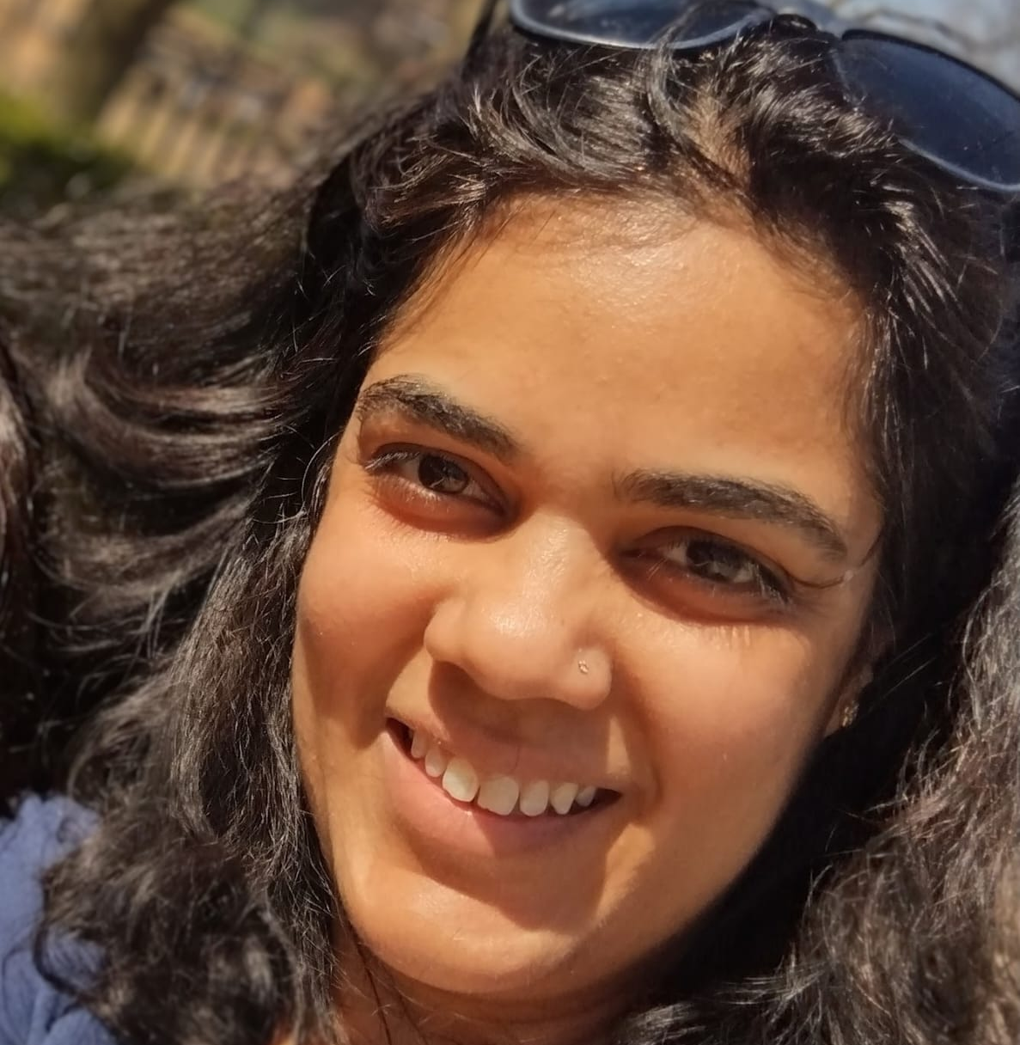
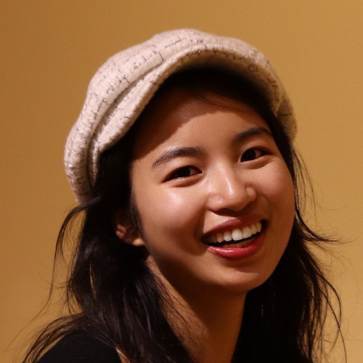
Your Compass Pro Bono team
Crystal Amah
Jennessa Tabba
Nate Oldach
Bridget Stack
Project Leader
Jen Yao
Neha Shekhawat

Slide 7
Project scope and background
Notes:
Speaker: Bridget

Slide 8
Project Background
2nd Story is working with Compass Pro Bono consultants to clarify its marketing plan and messaging and create a plan that will be both effective and achievable for 2nd Story’s small team.
Despite years of experience and overwhelmingly positive feedback from past clients, StoryBuilds has yet to gain the traction that would allow 2nd Story to both expand its reach and earned revenue from these programs.
The end goal of our engagement is to produce a “shovel-ready”StoryBuilds marketing plan and to have the understanding/buy-in of the Board and staff necessary to implement the plan.
Notes:
BES

Slide 9


StoryBuilds Marketing Project: Phase II
Strategic Framework
Marketing “Engagement Funnel”
Marketing Plan
Detail by Element/Channel/Contact point
Best Practices
With Competitive reference points (as relevant and available)
Ordered by Priorities
KPIs
Implementation Roadmap
Month by Month preparation, content development, deployment
Notes:
Bridget

Slide 10
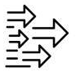



Key points: Discovery
 | Competitive - Primary Competitors start with significant name recognition, reach
 | When experienced, the value of 2nd Story and StoryBuilds is self evident. When, Where and How can prospective clients “sample” StoryBuilds?
 | Linking hard skill set development with softer skills and culture will increase perceived value, sell-in. Also, consider a “science” claim.
 | There is a need to develop a consistent StoryBuilds “story,” both the elevator pitch and a fuller sales conversation.
Notes:
Bridget

Slide 11
Revenue, Price Analysis for Competitors
In response to the question about how much of competitors' revenue is tied to training or storytelling services, Compass team conducted a review of publicly available financial data — including IRS Form 990s, annual reports, and audited financials.
Among primary competitors, 2nd Story is the only one that publishes financials directly on its website with a distinct line for StoryBuilds-related revenue.
Most competitors report total revenue only. Revenue from storytelling or corporate training is generally not reported as a distinct line item.
Pricing for services not available on websites (all invite you to contact them for detail)
Notes:
JEN Y

Slide 12
StoryBuilds Audience and Proposition are B2B, not B2C, sell
B2B Marketing in Professional Services
Category | B2B Professional Services (consulting, training)
Target Audience | Organizations or teams needing services
Decision Process | Strategic, committee-based, ROI-driven
Motivation | Business outcomes, compliance, culture
Sales Cycle | Long - proposals, demos, approvals
Tone | Professional, authoritative, supportive
Channels | LinkedIn, referrals, direct outreach
Content Strategy | Case studies, white papers, webinars
Pricing Focus | ROI, impact justification, custom pricing
Notes:
Bridget

Slide 13
Stakeholders re: 2nd Story & StoryBuilds past marketing
Themes:
📢 WOM, personal referrals, advocates in sector, board
🧠 Personal experience
🎤 Conferences
📉 Inconsistent promotional efforts, despite positive intentions
👥 Limited Staff capacity
Notes:
Bridget
Icon Suggestion: A megaphone with interconnected people or a group of avatars with chat bubbles – symbolizing word-of-mouth, referrals, and influence through networks.
Personal Experience Icon Suggestion: A silhouette of a person with a heart or thought bubble – indicating reflection, memory, or firsthand knowledge.
Conferences Icon Suggestion: A stage with a podium and audience or a microphone with a presentation screen – to represent speaking engagements or networking events.
Inconsistent Promotional Efforts, Despite Positive Intentions Icon Suggestion: A broken or jagged arrow going up and down, or a bullseye with arrows missing the center – conveying inconsistency or misaligned marketing.
Limited Staff Capacity Ico

Slide 14
“I think all of us are so excited to
be spreading the word about 2nd Story. I don't think all of us have the tools to do it.”
Notes:
Bridget

Slide 15
The Engagement Funnel – The Customer Journey
Objective
StoryBuilds
Engagement Focus
Awareness
Understanding
Enticing
Consideration
Intent
Sticky
Evaluation & Purchase
Retention & Advocacy
Notes:
Bridget

Slide 16
The StoryBuilds Engagement Funnel
StoryBuilds
Engagement Focus
Objective
Awareness
Focus: Introduce StoryBuilds and establish authority in the industry.
Understanding
Enticing
Focus: Nurture interest and leads by demonstrating how StoryBuilds can solve their specific problems and offer value.
Consideration
Intent
Sticky
Focus: Providing the information and resources necessary for making a buying decision.
Evaluation & Purchase
Focus: Building and maintaining strong relationships and fostering a loyal customer base.
Retention & Advocacy
Notes:
Bridget

Slide 17
The StoryBuilds Engagement Funnel
Key channels
Objective
Introduce
Keynote addresses
Expos
Podcasts
SEO, Adwords
Partnerships
Awareness
Understanding
Enticing
Consideration
Nurture
Website, LinkedIn
Email
Intent
Sticky
Encourage
1:1
Brochure(s)
Personalized proposal
Evaluation & Purchase
Retention & Advocacy
Retain
CRM Email
LinkedIn
Referral program
Notes:
Bridget

Slide 18
The StoryBuilds Engagement Funnel
Objective
Tactical Focus
Awareness
Provide interesting, relevant and valuable content
Understanding
Enticing
Consideration
Demonstrate the StoryBuilds value proposition with more detailed information.
Intent
Sticky
Offer clear information on options, benefits, pricing.
Evaluation & Purchase
Retention & Advocacy
Provide opportunities for feedback, ongoing demonstrations of LT value, encourage referrals and return engagements
Notes:
Bridget

Slide 19
Common Theme: Curate and Create Content
🎥 Video (Seeing is Believing)
🎧 Podcast clips
🧱 StoryBuilds demos
⭐ Client Testimonials and Results (Trust, Proof)
💡Tips for boosting/maintaining employee engagement, professional development, and culture
🎤 Keynote Addresses (Authority)
📰 Industry news
📄 Articles (Thought Leadership, proof of value proposition)
📨 CRM (newsletters, SB news, thought leadership)
🔗 LI (webinars, industry news, thought leadership)
Notes:
Bridgetdd

Slide 20
Implementation Priorities
First: StoryBuilds “Elevator” Speech
Second: StoryBuilds website - optimize to be “B2B/corporate-friendly”
Third: LinkedIn site and posting content/calendar (create and optimize)
Fourth: Brochures and Media Kit - update, reflecting Elev. Speech, site revisions
Fifth: CRM content and email schedule
Sixth: Conferences, Expos (e.g. HR, lawyers’ events) research
Notes:
Bridget

Slide 21
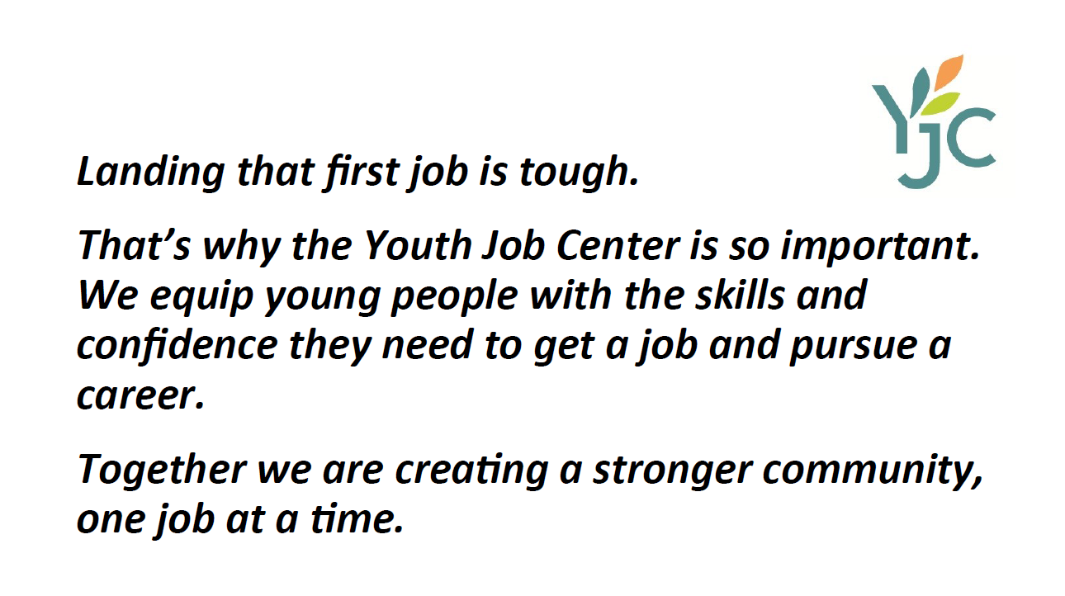
Develop your elevator speech
70 words max
Teach board and stakeholders
Stay on script
For example only
Notes:
NATE

Slide 22
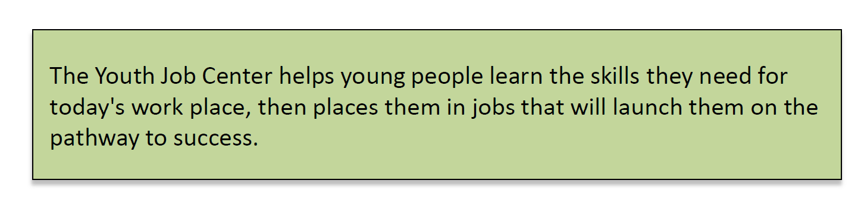
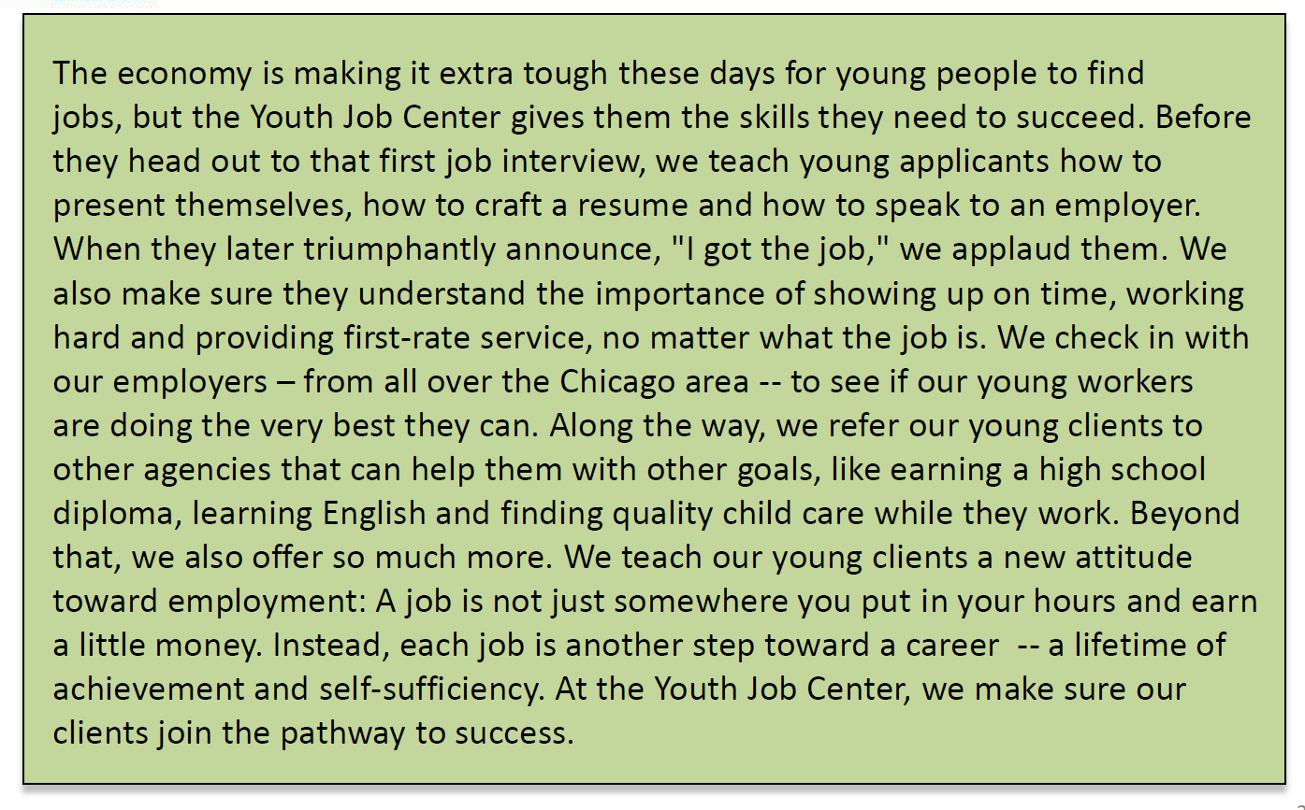
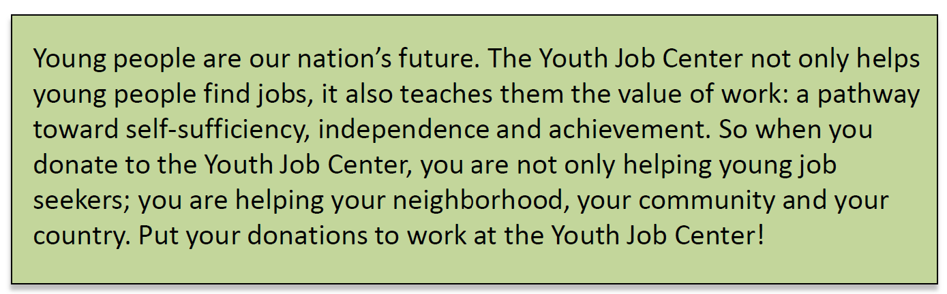
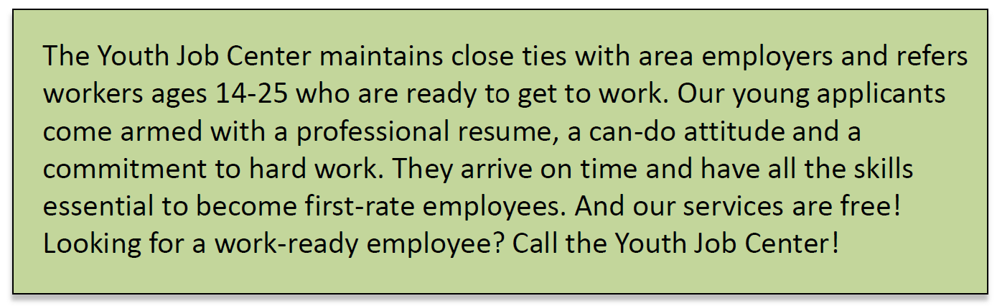
Then write these versions
In 10-25 words
In 150 - 250 words
For 2 or 3 key target audiences
For example only
To donors
To employers
For example only
Notes:
NATE

Slide 23
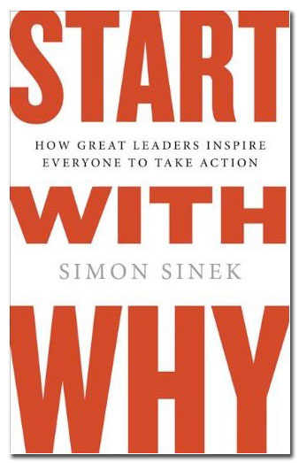
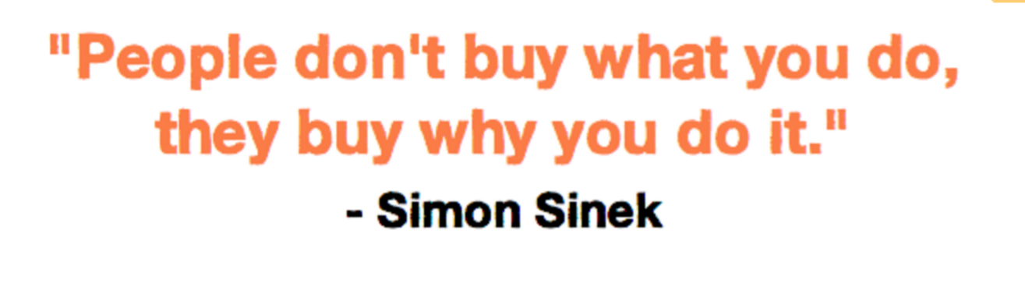
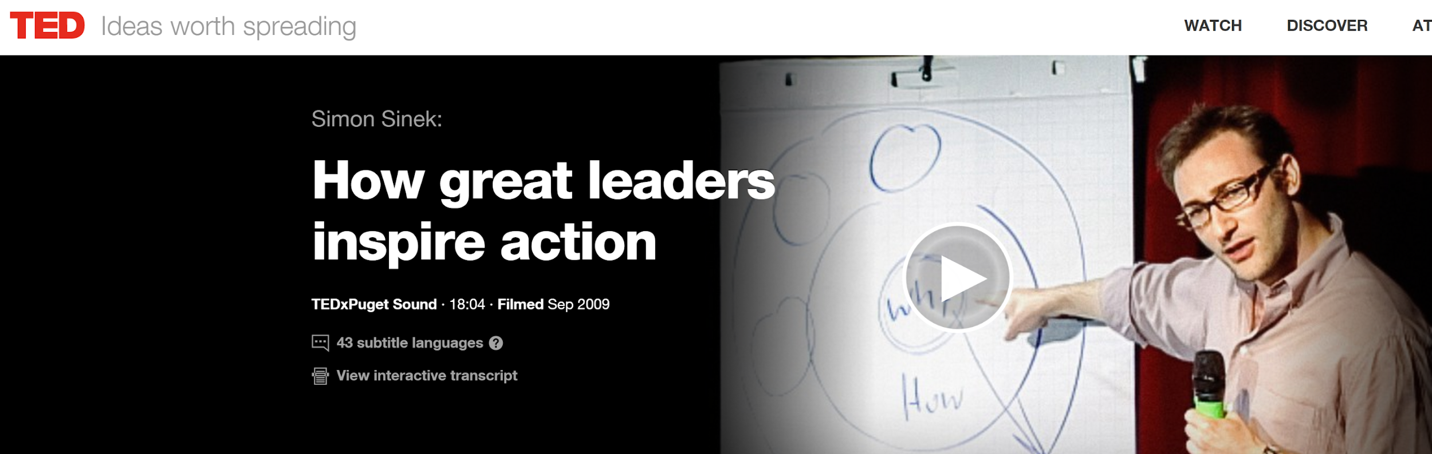
Option 1: Simon Sinek’s Why, How, What model: Start with the Why
Notes:
NATE

Slide 24
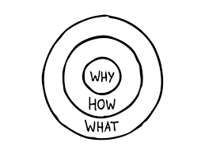
Option 1: Simon Sinek’s Why, How, What model
WHY 🔹 Purpose / Cause / Belief
The core belief of the business or individual
Why do you exist? Why should anyone care?
HOW 🔹 Process / Unique Approach
The values, principles, and methods that make you stand out
How do you do what you do differently or better?
WHAT 🔹 Product / Service / Result
The tangible outcome or offering
What do you do or sell?
Notes:
NATE

Slide 25
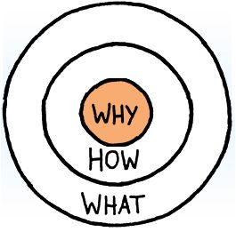


Example: Apple doesn’t start with What they make
"We make great computers. They're beautifully designed, simple to use and user friendly.
Want to buy one?"
Notes:
NATE

Slide 26
…then how with you solve for their problem.
"Everything we do, we believe in challenging the status quo. We believe in thinking differently. The way we challenge the status quo is by making our products beautifully designed, simple to use and user friendly.
Notes:
NATE

Slide 27
…then the benefits and closing the deal!
"Everything we do, we believe in challenging the status quo. We believe in thinking differently. The way we challenge the status quo is by making our products beautifully designed, simple to use and user friendly. We just happen to make great computers.
Want to buy one?"
Notes:
NATE

Slide 28

So…
What’s your why
Notes:
NATE

Slide 29
Option 2: Simple, “Mad Libs Style” Elevator Speech Template
"For (target audience), (brand name) is the (category/frame of reference) that delivers (benefit/point of difference POD) because only (brand) is (reason to believe).”
(based on a format for developing a value proposition statement)
Notes:
NATE

Slide 30
Simple, AI-generated examples for StoryBuilds …
as example starting point … 70 word version
For HR professionals and team development leaders, StoryBuilds by 2nd Story Theater is the interactive workshop experience that delivers lasting improvements in communication, collaboration, and team culture. Because only StoryBuilds is rooted in live theater techniques, it engages participants emotionally and experientially—sparking creativity, building trust, and equipping teams with practical skills they can apply immediately in the workplace. (66 words)

Slide 31
Simple, AI-generated examples for StoryBuilds …
as example starting point … 30 word version
For HR and team development leaders, StoryBuilds is the interactive workshop that builds communication and connection—because only StoryBuilds uses live theater techniques to create lasting engagement and impact. (29 words)
Notes:
NATE

Slide 32

Elevator Speech: Additional considerations
Craft a connection from soft skill development to hard skill development
Professional development and/or Employee Engagement?
Science/Research back-up claim
Largely “white space” among competitors
May help connect soft to hard skills
Check out competitors’ websites: See their opening paragraphs after headlines
Notes:
NATE

Slide 33

Optimize StoryBuilds website for B2B audience
Website Best Practices
Competitor Comparison
Implications for StoryBuilds
Notes:
CRYSTAL

Slide 34
Best practices for a ‘corporate friendly’ website Landing Page
Clear, Compelling Headline Captures attention immediately by communicating the value of your service or solution.
Subheadline with Key Benefits Briefly expands on the headline with specific outcomes a business client can expect.
Professional Hero Image or Video High-quality visuals that reflect your brand’s professionalism and align with corporate standards.
Call to Action (CTA) Above the Fold Prominently placed CTA encourages immediate engagement (e.g., “Book a Demo,” “Contact Us”).
Value Proposition Section A concise explanation of what you offer, who it's for, and why it matters, ideally within the first scroll.
Trust Signals Logos of past clients, testimonials, reviews, or certifications that build credibility.
Case Study or Use Case Real-world examples that demonstrate success and ROI for similar clients.
About the Company Humanizes the brand with mission, leadership, and organizational background.
Lead Capture Form Easy-to-complete form for inquiries or downloads, ideally minimal fields to reduce friction.
FAQ Section Preemptively answers common client questions to reduce uncertainty and boost confidence.

Slide 35
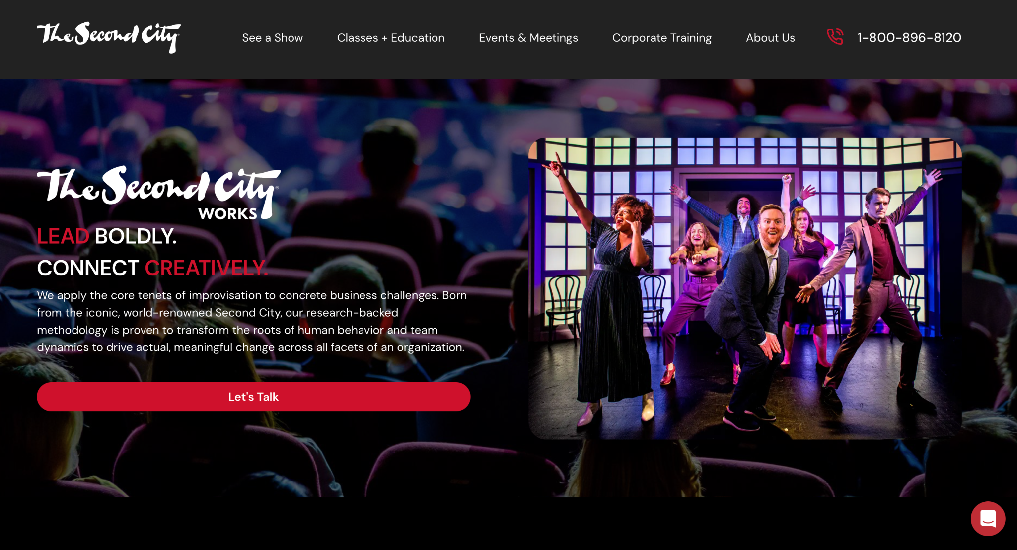
Second City Works Landing Page - well optimized
Observable from this screenshot:
Compelling headline
Sub-line with key benefits
Professional hero image
Call to action
Clear method of contact (number listed at top, chat feature.
https://www.secondcity.com/second-city-works
Notes:
CRYSTAL

Slide 36
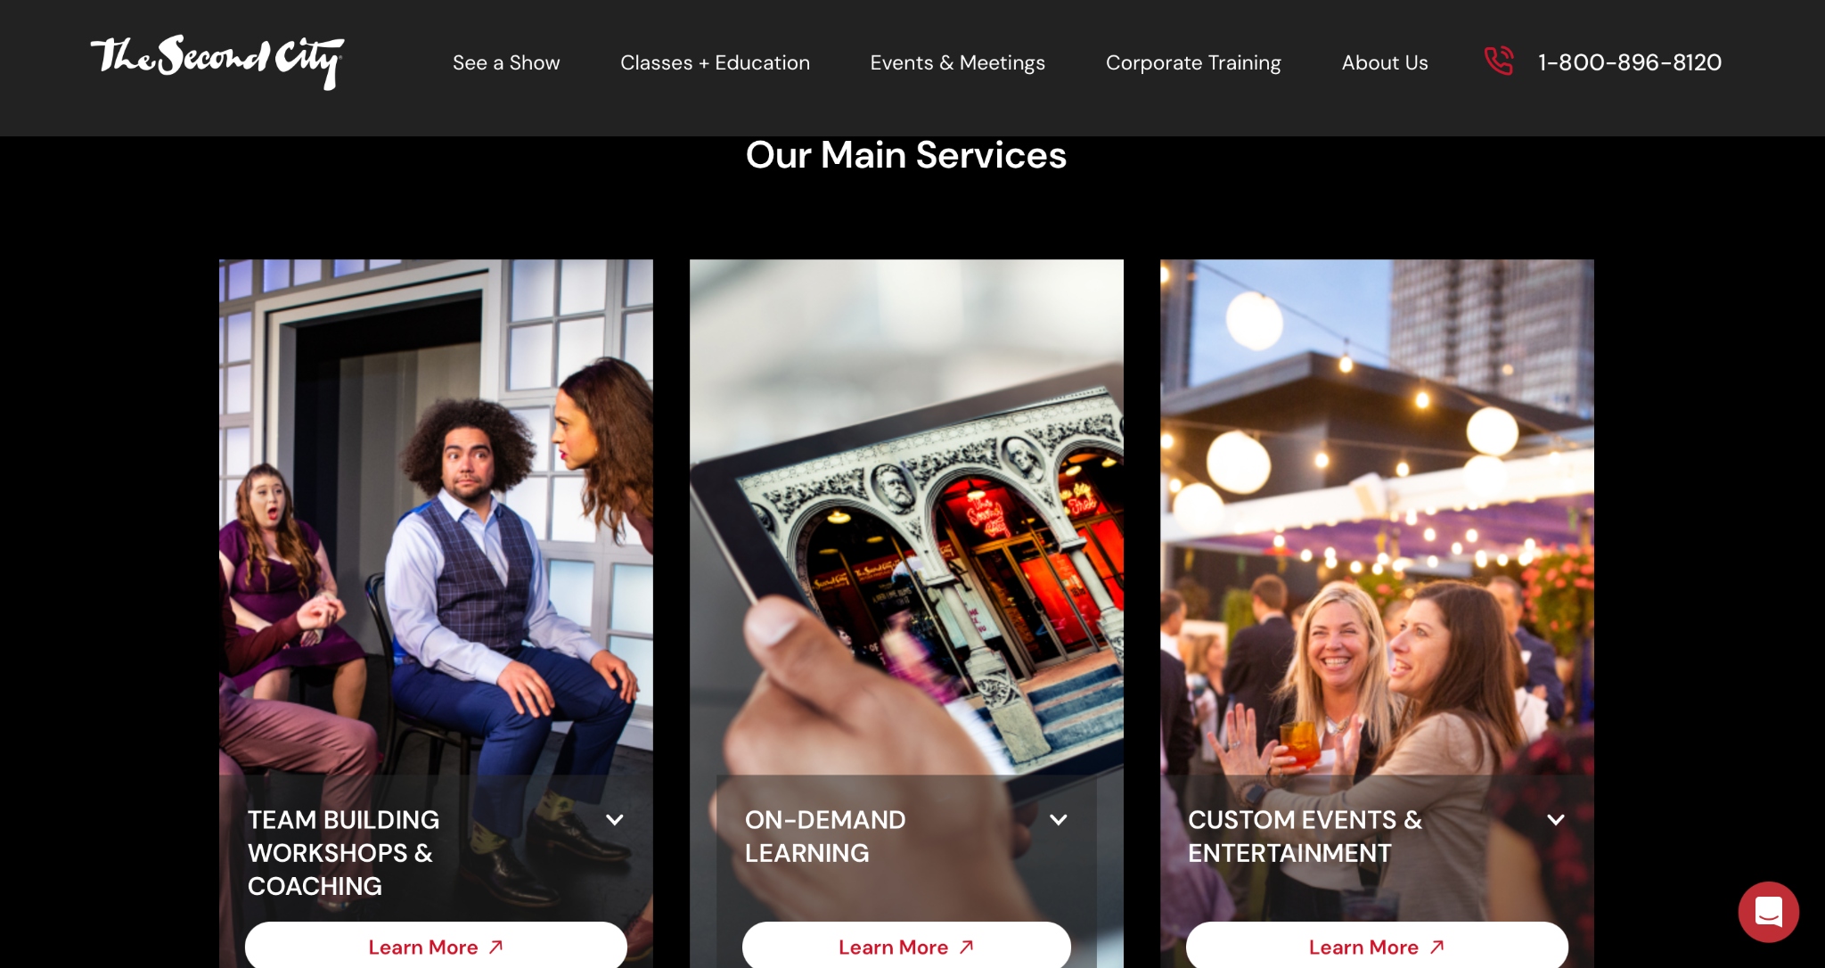
Second City Works Landing Page - well optimized
Observable from this screenshot:
Workshop offerings
Value proposition section (once user clicks the ‘Learn more’ button)
High quality images
Notes:
CRYSTAL

Slide 37
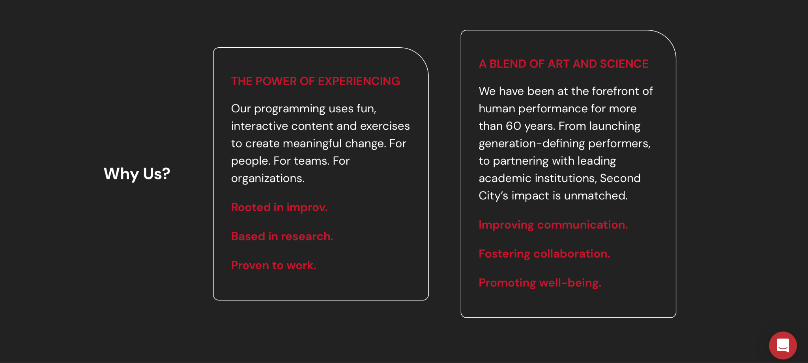
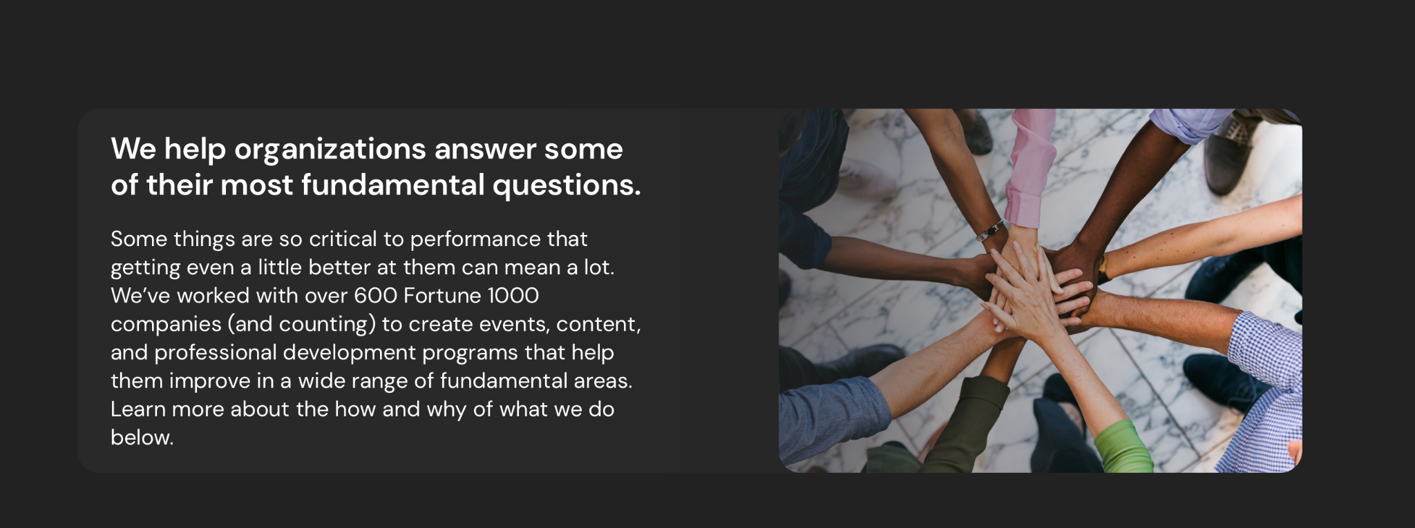
Second City Works Landing Page - well optimized
Observable from this screenshot:
Value proposition section (expanded)
Trust signals
About the company

Slide 38

Second City Works Landing Page - well optimized
Observable from this screenshot:
Value proposition section (expanded)
Trust signals
About the company
Clientele

Slide 39
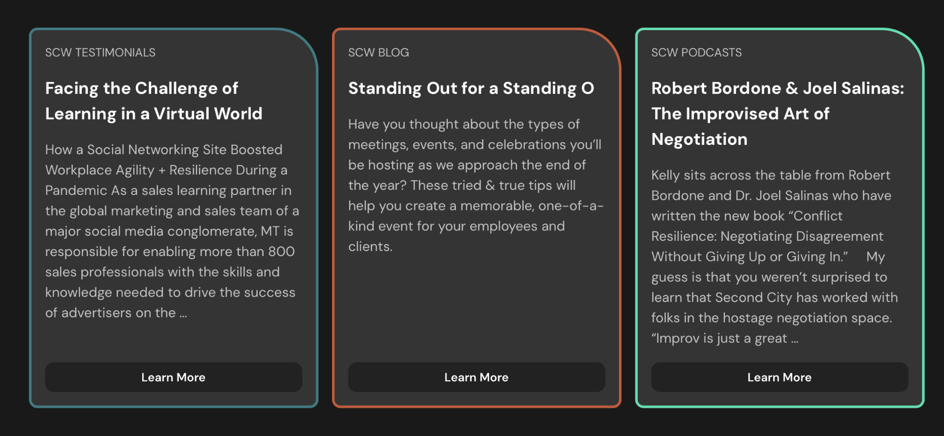
Second City Works Landing Page - well optimized
Observable from this screenshot:
Trust signals (diverse platforms to exhibit thought leadership, testimonials)
Notes:
CRYSTAL

Slide 40
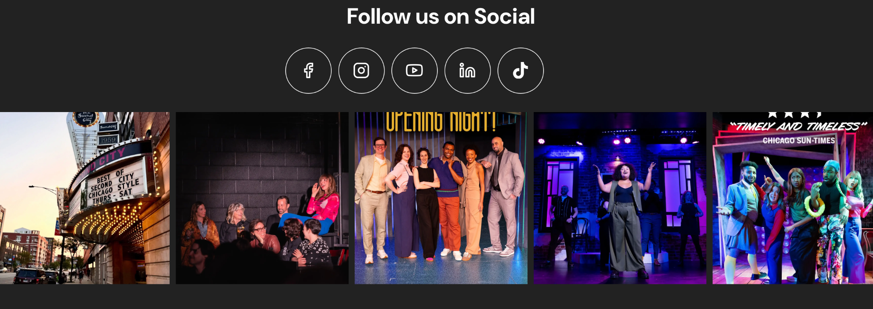
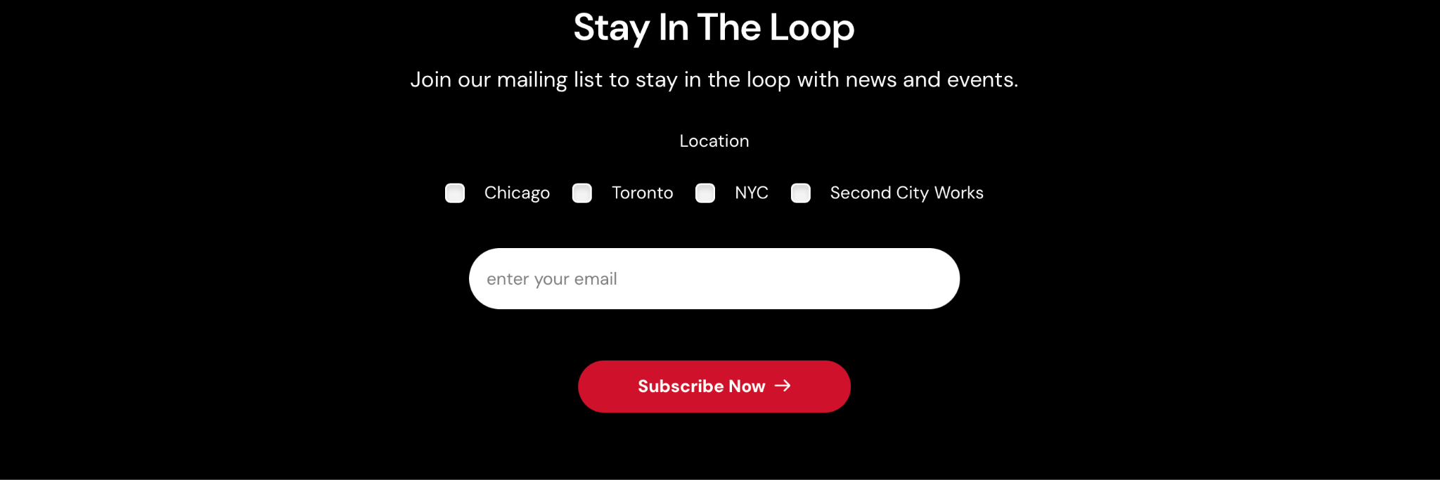
Second City Works Landing Page - well optimized
Observable from this screenshot:
Link to social platforms
Lead capture form (option to subscribe via email)
Notes:
CRYSTAL

Slide 41
B2B Landing Page Best Practices: Competitive Comparison
 | StoryBuilds (2nd Story) | Steppenwolf IMPACT | MothWorks (The Moth) | Second City Works
Clear, Compelling Headline |  | ✔ | ✔ | ✔
Subheadline with Key Benefits |  |  | ✔ | ✔
Professional Hero Image or Video | ✔ |  |  | ✔
Call to Action (CTA) above the fold | ✔ | ✔ | ✔ | ✔
Value Proposition Section | ✔ |  | ✔ | ✔
Workshop Offerings Overview |  |  | ✔ | ✔
Trust Signals |  |  | ✔ | ✔
Case Study or Use Case |  |  | ✔ | ✔
About the Company | ✔ | ✔ | ✔ | ✔
Lead Capture Form | ✔ |  |  | ✔
FAQ Section |  |  |  | ✔

Slide 42


Good time for an SEO check in… AI is transforming SEO
From Search Engine Optimization to Answer Engine Optimization
Being the source of the answer boosts brand visibility and credibility, even without a click.
The Future: Hybrid SEO + AEO Strategy
Optimize not just for rankings, but for being cited by AI and featured answers.
Blend classic SEO (links, speed, mobile) with AEO (clarity, structure, question focus)

Slide 43
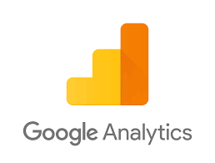
Website Key Performance Indicators (KPI’s)
Utilize Google Analytics to track
Page Views – are people visiting StoryBuilds pages?
Traffic Source Breakdown – where are visitors coming from (social, search, direct, etc.)?
Form Submissions - are people taking action (e.g., filling out contact forms)?
Helps you understand how people are finding you and whether they’re taking the next step

Slide 44

Create and optimize LinkedIn for StoryBuilds
Best Practices
Competitor Profile Comparison
Implications for StoryBuilds
Notes:
NEHA

Slide 45
Linkedin Best Practices
Primary Audience: HR professionals, L&D, and DEI leaders, Final decision makers
Optimize LinkedIn Page:
Include a compelling tagline,
Add a custom CTA button (in 2ndStory’s case a button that takes you to StoryBuilds webpage)
Customize About section and Speciality (SEO friendly keywords)
Post with purpose:
Content relevant to professional audience
Use relevant hashtags
Consider repacking content in different formats
Maintain a consistent posting schedule
Leverage Staff and Board Networks
Join and engage in relevant groups
Assess results and Adjust KPIs and practices based on results
Resource: LinkedIn for Nonprofit

Slide 46
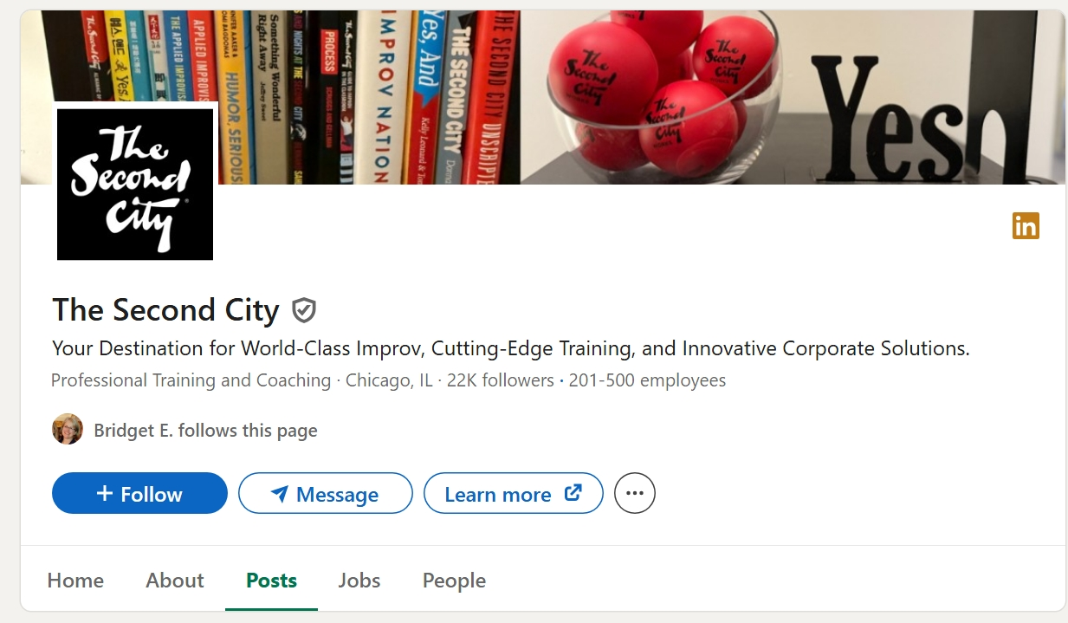
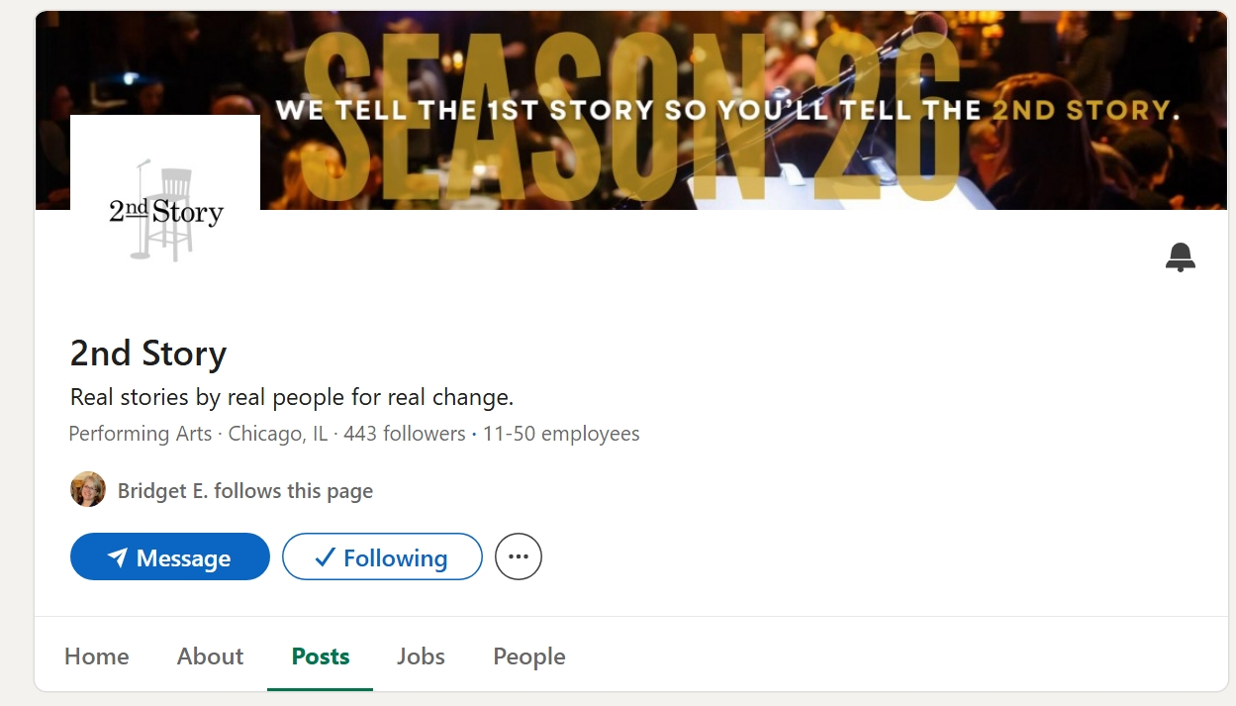
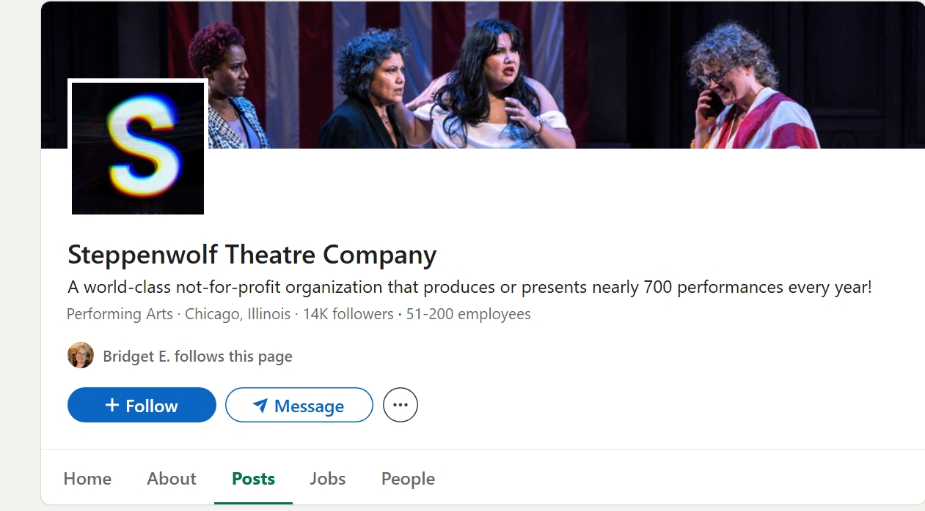
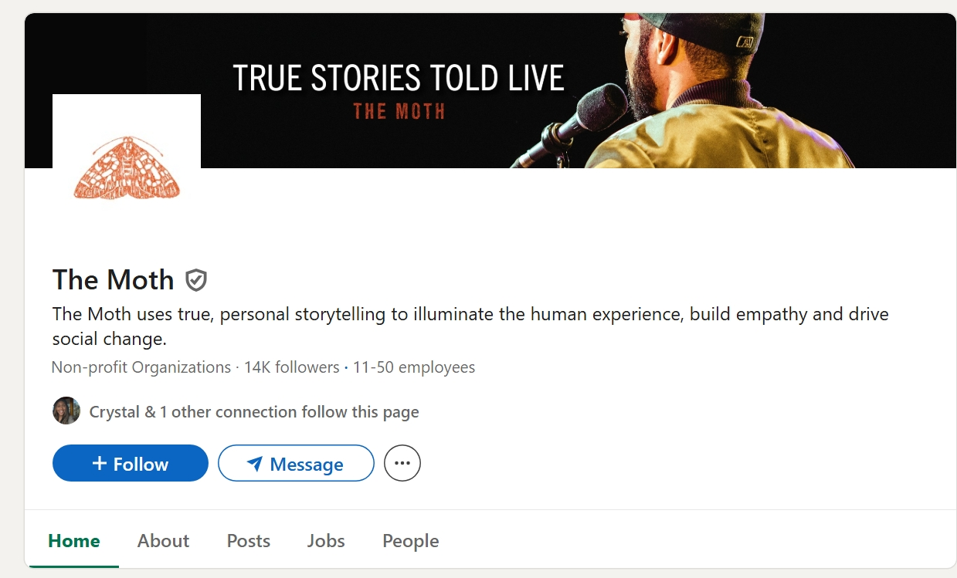
Second City excels at LinkedIn use and optimization
Headline | Description | No. of followers | Content | Most recent post | Frequency
Your Destination for World-Class Improv, Cutting-Edge Training, and Innovative Corporate Solutions. | Professional Training and Coaching | 22,219 | On LinkedIn their focus is specifically on professional training and coaching | few hours ago | every day
Real stories by real people for real change. | Performing Arts | 443 | General: not specific to StoryBuilds | 2 months ago | *** Have been active 9 months ago,
A world-class not-for-profit organization that produces or presents nearly 700 performances every year! | Performing Arts | 14,491 | General: not specific to IMPACT | one week ago | once-twice a week
The Moth uses true, personal storytelling to illuminate the human experience, build empathy and drive social change | Non-profit Organizations | 13,906 | No specific content on MothWorks | two weeks ago | once every two weeks
Notes:
NEHA

Slide 47
The Second City
LinkedIn is being used strategically and specifically for The Second City Works
This link directs to The Second City Works page
Notes:
NEHA

Slide 48
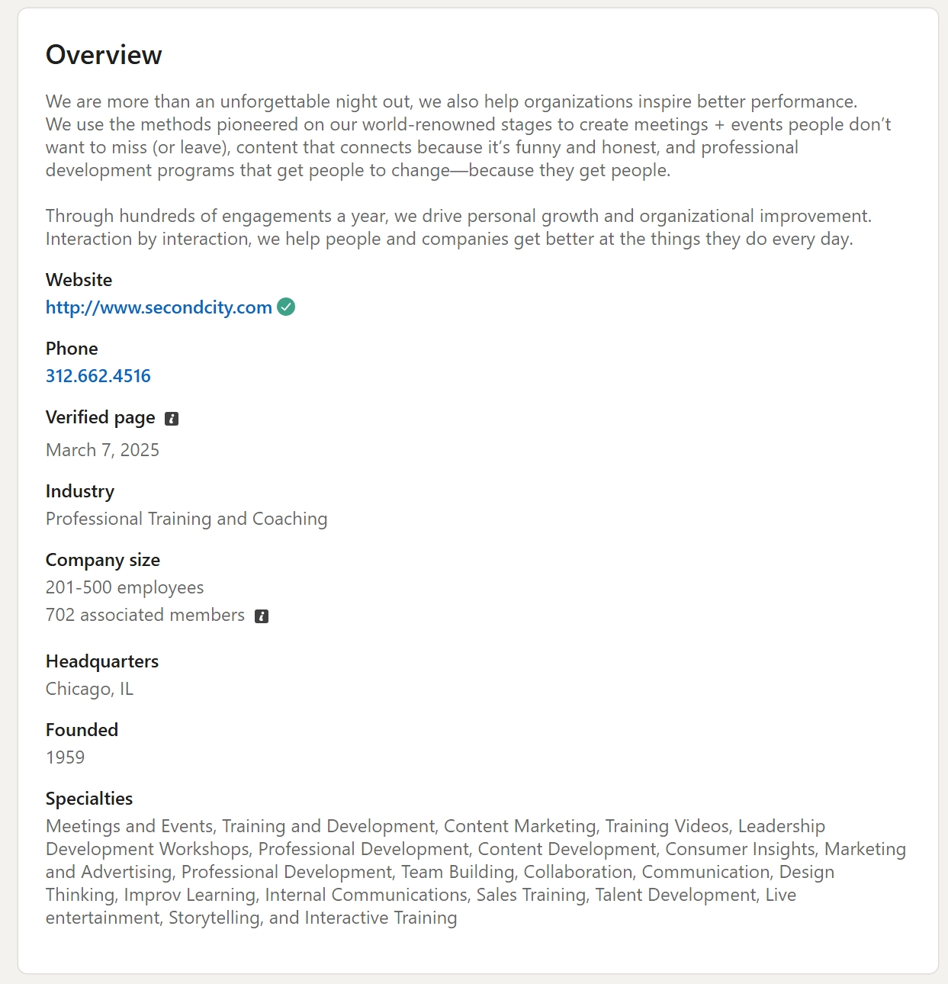
Second City LI - Strategic SEO-conscious approach
Intentional positioning and strategic use of keywords
Notes:
NEHA

Slide 49
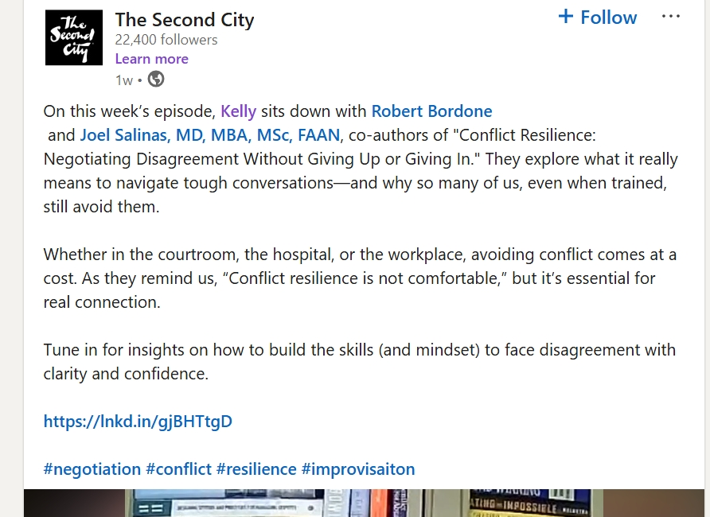
Content that resonates with LinkedIn’s professional community
Featuring accomplished experts builds trust and signals quality
Targeted directly to LinkedIn professionals
Clear ‘Call-to-Action’ Button
use of relevant hashtags for extended reach and visibility
Notes:
NEHA

Slide 50
MothWorks and Steppenwolf Impact fail to optimize, leverage LinkedIn
Headlines are the Parent Co’s, not specific to training service
Generic “About” section, do not highlight training, workshops
Indistinct Posts, no customization for a professional audience
Use Organic/Instinctive keywords rather than Intentional/Strategic
Navigate to Appendix
Navigate to Appendix
Notes:
NEHA

Slide 51
StoryBuilds LinkedIn Implementation Plan
First Priority
(now)
Short-term
(in 3-6 month time)
Long-term
Optimize Linkedin Page
Create Posting Calendar
Develop a content plan (Assemble and produce content)
Start Posting
Build network and visibility
Encourage Community Engagement
Offer Social Proof
Assess and refine the existing strategy
Organize promotional events
Leverage Linkedin Ads
Strategic Collaboration
Navigate to Appendix for Short and Long Term details
Notes:
NEHA

Slide 52
Details
First Priority
(now)
Optimize Linkedin Page:
Compelling Tagline
About Section- focus on keywords and speciality
Create Posting Calendar:
Post frequency (3-5 times per week)
Post Themes (eg. client spotlights, polls etc)
Develop a content plan: (Assemble and produce content)
Client/workshop spot light
Insights visual (carousels)
Thought leadership: articles/blog related to StoryBuilds by executives/board members/staff
Short form promotional videos/Podcasts
Event announcements
Start Posting!
Navigate to Appendix for Short and Long Term details
Notes:
NEHA

Slide 53
Linkedin Final Thoughts
All 2nd Story stakeholders - Staff, Board and Company - have LI responsibilities
Update personal LI profiles
Repost StoryBuilds content (as appropriate)
Encourage/Require “following” StoryBuilds LI page
Add LI link to website (wherever social media links are)
In first several CRM communications, directly ask recipients to follow StoryBuilds on LI, to look for SB on LI
Notes:
NEHA

Slide 54
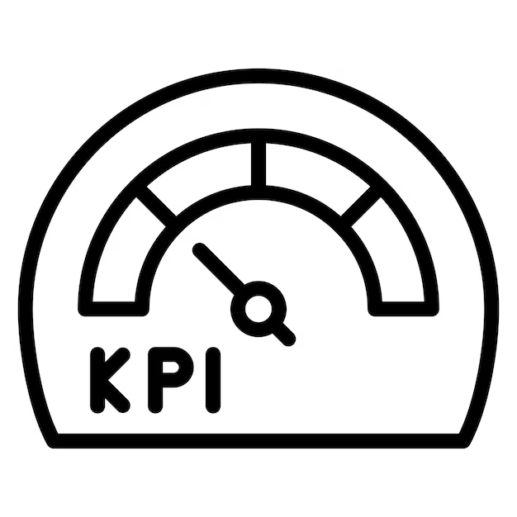
LinkedIn Key Performance Indicators (KPI’s)
Follower Growth – Is your audience growing over time?
Post Engagement (likes/comments/shares per impression) – Is your content sparking interaction?
Gives a pulse on visibility and resonance with your content.

Slide 55

CRM content and email schedule
Best Practices
Implications for StoryBuilds
Notes:
NEHA

Slide 56

CRM Best Practices
Clear Strategy and Set-up: Goals, tools, database
Build out database: Incl relevant info & segmentation, log interactions
Streamline & Define workflow
Track StoryBuilds Impact
Stay engaged with consistency
Navigate to Appendix for details
Notes:
NEHA

Slide 57
CRM follows a customer through their journey
Lead Capture
Collect Contact Info
Nurture and
Re Engage
Initial Outreach
Maintain momentum and reignite interest
Automate Welcome email
StoryBuilds workshop delivery
Assess and understand needs
Deliver the workshop and collect feedback
Proposal and booking
Understand client needs
Send a tailored proposal
Notes:
NEHA

Slide 58
CRM follows a customer through their journey
Lead Capture
Collect Contact Info
Retain, Re-engage, Nurture
Focus: Building and maintaining strong relationships and fostering a loyal customer base.
Tactics: Provide ongoing demonstrations of LT value, opportunities for feedback,and encourage referrals
Nurture and Re Engage
Initial Outreach
Maintain momentum and reignite interest
Automate Welcome email
StoryBuilds workshop delivery
Assess and understand needs
Deliver the workshop and collect feedback
Understand client needs
Proposal and booking
Send a tailored proposal
Notes:
NEHA

Slide 59

Content: Updates, Proof/Thought Leadership, Incentives/Offers, Personalized Reach-outs
Podcast Snippets
Upcoming event Calendar
(LinkedIn Event, Conferences SB will be present)
Workshop Invitation
Workshop Highlights/Client Spotlight
Nurture and Re-engage
Check-ins
(eg. still interested emails)
Special Offers
(early bird offers, referral incentives)
Thought Leadership
(blogs/posts/podcasts/professional development tips etc authored by leaders)
Navigate to Appendix for details
Notes:
NEHA

Slide 60
CRM Key Performance Indicators (KPI’s)
Utilize Mailchimp to track
Open Rate – Are people opening your emails?
Click-through Rate – Are they interested enough to click and learn more?
Unsubscribes – Are you keeping your audience, or losing them?
Reveals how effectively you’re keeping your existing community informed and engaged

Slide 61
Implementation Roadmap
Notes:
Speaker: Jennessa

Slide 62
Implementation Roadmap
First
Foundation work
StoryBuilds “Elevator” Speech
Second
Web presence
StoryBuilds website - optimize to be “B2B/corporate-friendly”
Third
Socials
LinkedIn site and posting content/calendar - create and optimize
Fourth
Collateral
Brochures and Media Kit - update, reflect Elev. Speech and site revisions
Fifth
Customer cadence
CRM content and email schedule
Sixth
Event presence
Conferences, Expos (e.g. HR, lawyers events) research
Notes:
JENNESSA
setup :
reflecting priorities, order, some wrap up if needed
chunked out for digesting
First: StoryBuilds “Elevator” Speech
Second: StoryBuilds website - optimize to be “B2B/corporate-friendly”
Third: LinkedIn site and posting content/calendar - create and optimize
Fourth: Brochures and Media Kit - update, reflect Elev. Speech and site revisions
Fifth: CRM content and email schedule
Sixth: Conferences, Expos (e.g. HR, lawyers events) research

Slide 63
Implementation Timeline
Aug
Sept
Oct
Dec
Jan
Feb
W1
W2
W3
W4
W1
W2
W3
W4
W1
W2
W3
W4
W1
W2
W3
W4
W1
W2
W3
W4
W1
W2
W3
W4
Elevator Speech
Website optimization
Create, optimize LinkedIn
Brochures, media kit
CRM content, email schedule
take a break in November for catch up
Conferences, expos Research

Slide 64
Secondary efforts, once first priorities implemented
2026 - Podcast opportunities
research options, incl. networking
2026 - Partnerships
research, target list, contact plan, incl. networking
2026 - Referral Program
defined, implemented via CRM (and maybe LI if appropriate)
2026 - Ongoing Analytics & Optimization
Quarterly (min) review and program execution adjustment
Notes:
JENNESSA

Slide 65
Summary
Notes:
BRIDGET

Slide 66
StoryBuilds Marketing Plan built to Objectives
Objective
Engagement Focus
Awareness
Focus: Introduce StoryBuilds and establish authority in the industry.
Understanding
Enticing
Focus: Nurture interest and leads by demonstrating how StoryBuilds can solve their specific problems and offer value.
Consideration
Intent
Sticky
Focus: Providing the information and resources necessary for making a buying decision.
Evaluation & Purchase
Focus: Building and maintaining strong relationships and fostering a loyal customer base.
Retention & Advocacy
Notes:
BRIDGET

Slide 67
StoryBuilds Funnel - Channels to meet objectives
Objective
Key channels
Introduce
Keynote addresses
Expos
Podcasts
SEO, Adwords
Partnerships
Awareness
Understanding
Enticing
Consideration
Nurture
Website, LinkedIn
Email
Intent
Sticky
Encourage
1:1
Brochure(s)
Personalized proposal
Evaluation & Purchase
Retention & Advocacy
Retain
CRM Email
LinkedIn
Referral program
Notes:
BRIDGET

Slide 68
Implementation Priorities
First: StoryBuilds “Elevator” Speech
Second: StoryBuilds website - optimize to be “B2B/corporate-friendly”
Third: LinkedIn site and posting content/calendar (create and optimize)
Fourth: Brochures and Media Kit - update, reflecting Elev. Speech, site revisions
Fifth: CRM content and email schedule
Sixth: Conferences, Expos (e.g. HR, lawyers’ events) research
Notes:
Bridget

Slide 69
Accountability for optimization: Regular KPI review with quarterly trends to identify what's working and where to adjust
Website
LinkedIn
CRM
Use Google Analytics to track
Use Mailchimp to track
Page Views
Traffic Source Breakdown
Form Submissions - are people taking action?
Follower Growth
Post Engagement - likes/comments/ shares per impression
Open Rate
Click-through Rate
Unsubscribes
Notes:
BRIDGET

Slide 70
Implementation Timeline
Aug
Sept
Oct
Dec
Jan
Feb
W1
W2
W3
W4
W1
W2
W3
W4
W1
W2
W3
W4
W1
W2
W3
W4
W1
W2
W3
W4
W1
W2
W3
W4
Elevator Speech
Website optimization
Create, optimize LinkedIn
Brochures, media kit
CRM content, email schedule
take a break in November for catch up
Conferences, expos

Slide 71
StoryBuilds Marketing Plan - Why it works
Provides a strategic engagement framework - clear objectives, what to do at each step of client journey and the Why
Built to meet a B2B audience - meets potential and current clients with relevant messages in contexts best suited to the journey stage
Incorporates understanding of competitive landscape and challenges
Reflects insights gleaned from client, stakeholder conversations
Realistic, achievable, “check the box” implementation plan ordered by priority
Clear KPIs to guide quarterly assessment, optimization to plan
Notes:
BRIDGET

Slide 72
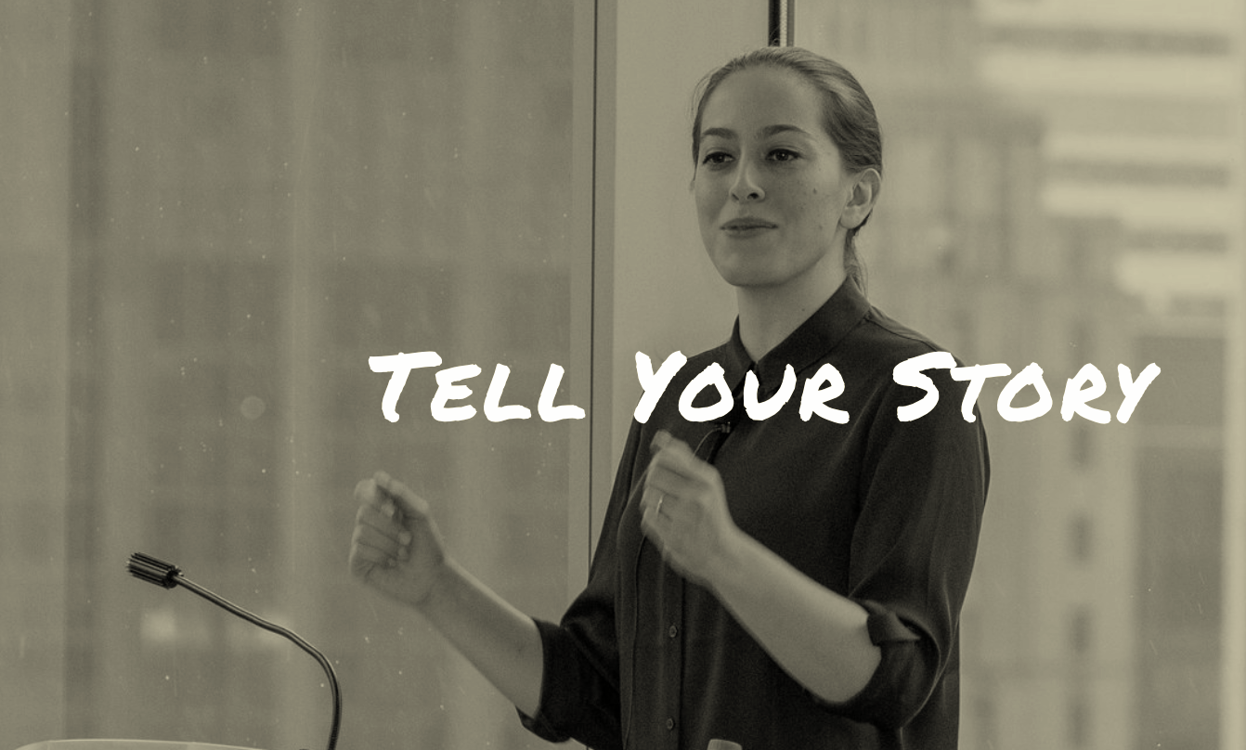
Thank you
Notes:
Bridget

Slide 73
Questions, Discussion

